Slide 1
An NSS Audio-Visual
Library Presentation
Gypsum in Caves
K L Day (1989)
S304 62 Slides 2/13/2021
Notes:
The following collection of slides is by no means a comprehensive catalogue of all gypsum occurrences in caves. It also cannot take the place of a textbook in mineralogy, or Cave Minerals of the World by Hill and Forti. However, most of the morphologies of cave gypsum, both common and rare, are shown in this series of slides compiled over a fourteen-year time period by Kenrick L. Day.

Slide 2
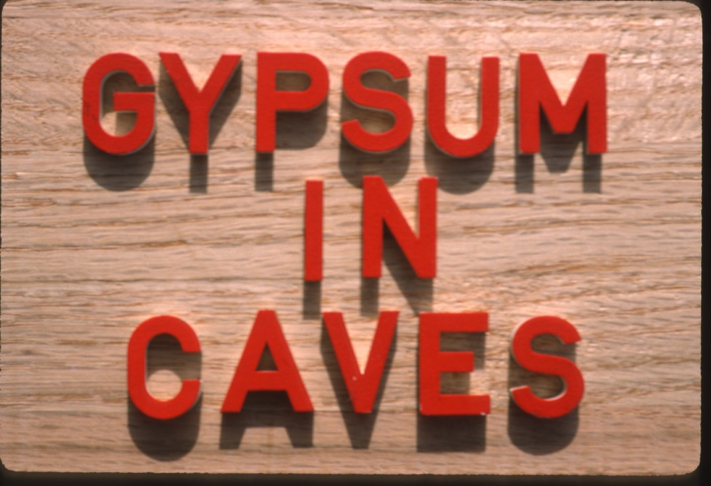

Slide 4
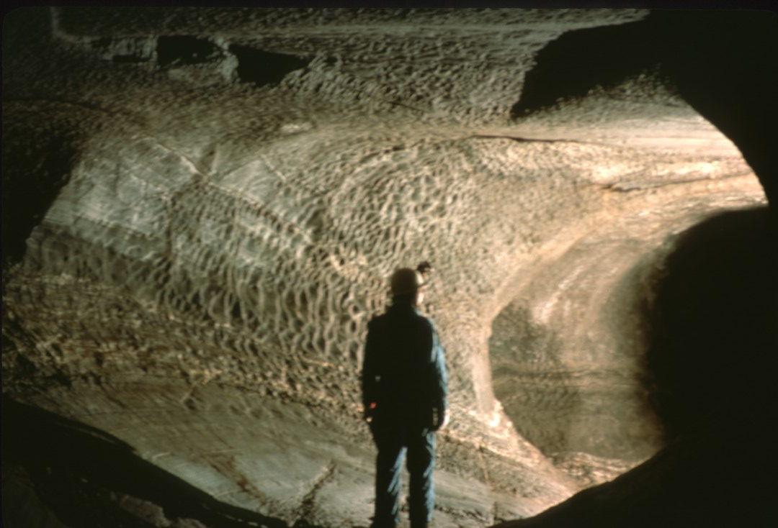
Notes:
The primary thrust of this slide series is secondary gypsum deposition in caves. However, it must be noted that some caves are actually formed in gypsum, that is, in gypsum bedrock. This photo was taken in Border Cave, Texas, a true gypsum cave. The cave is primarily a heavily scalloped borehole draining a half-mile wide sinkhole. Like most caves formed in gypsum, this cave contains few formations.

Slide 5
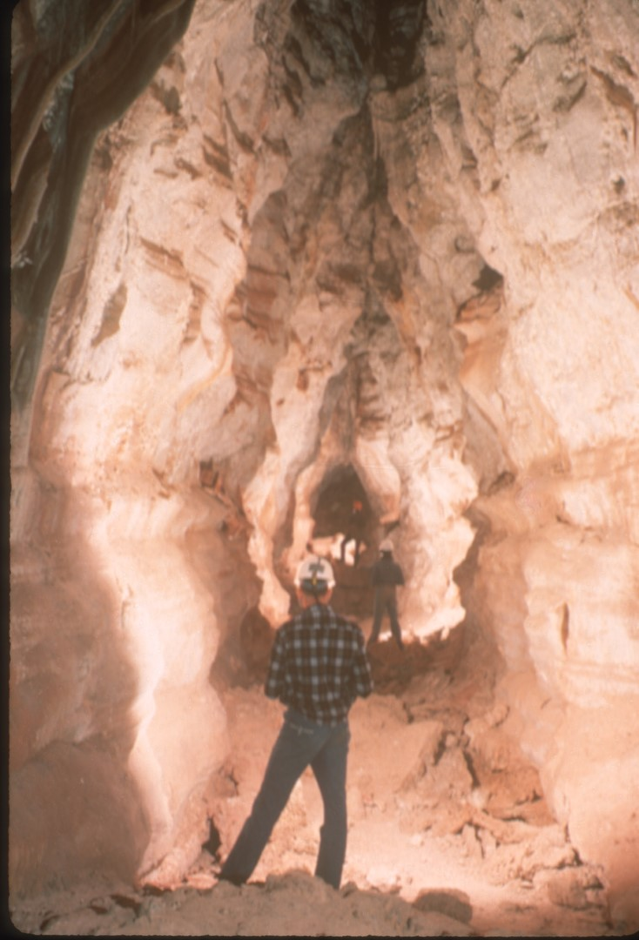
Notes:
Secondary cave gypsum is frequently observed in crusts on limestone. In the cave shown here, the crust occurs as a fine white powder on the walls. This material originated in seeping water.

Slide 6
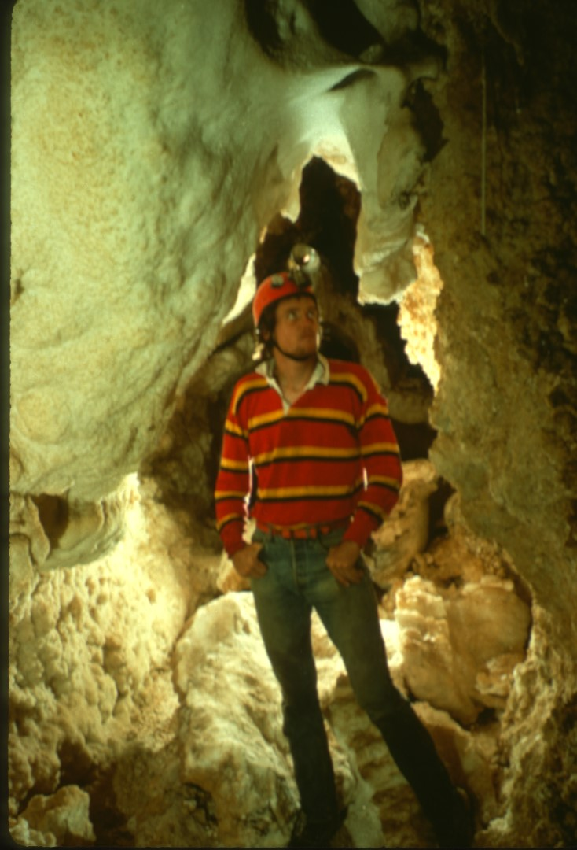
Notes:
The gypsum crusts are much more prominent in this cave, totally obscuring the limestone bedrock for much of the passage. The gypsum crystal axis are oriented perpendicular to the crust.

Slide 7
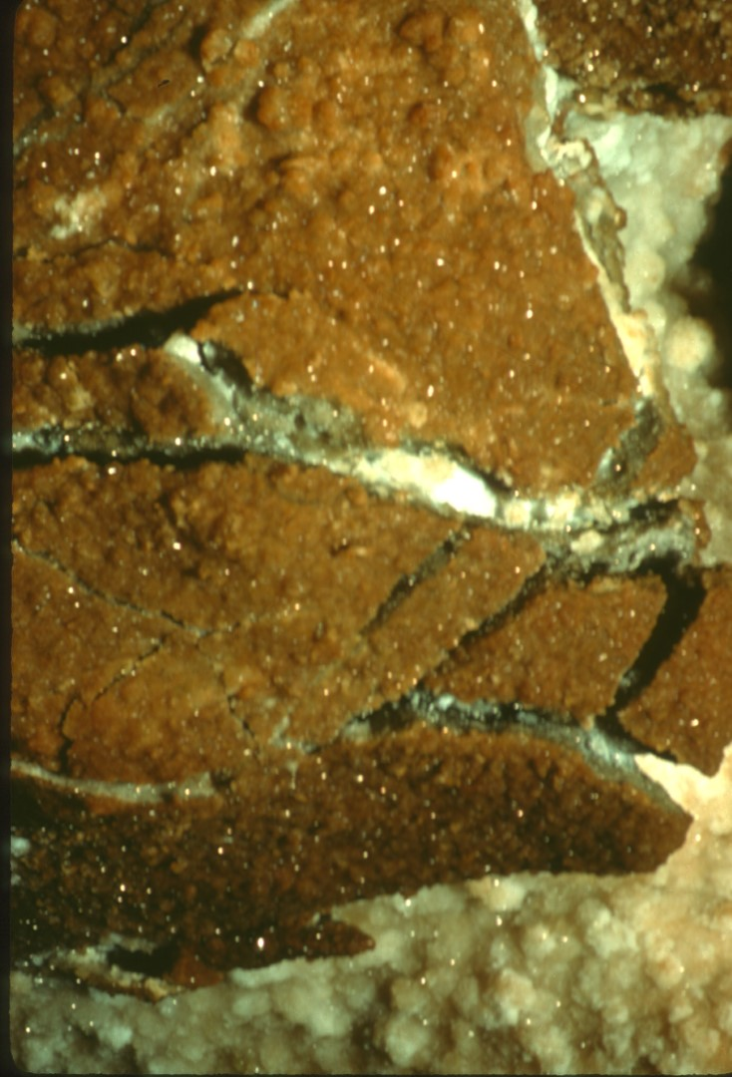
Notes:
Here is an excellent example of gypsum exfoliation in an Arkansas cave. The gypsum crust is expanding into the passage as new material is added to the base of the crystals from seeping water. This has sufficient force to shatter an older, overlying crust. This phenomenon is very commonly observed.

Slide 8
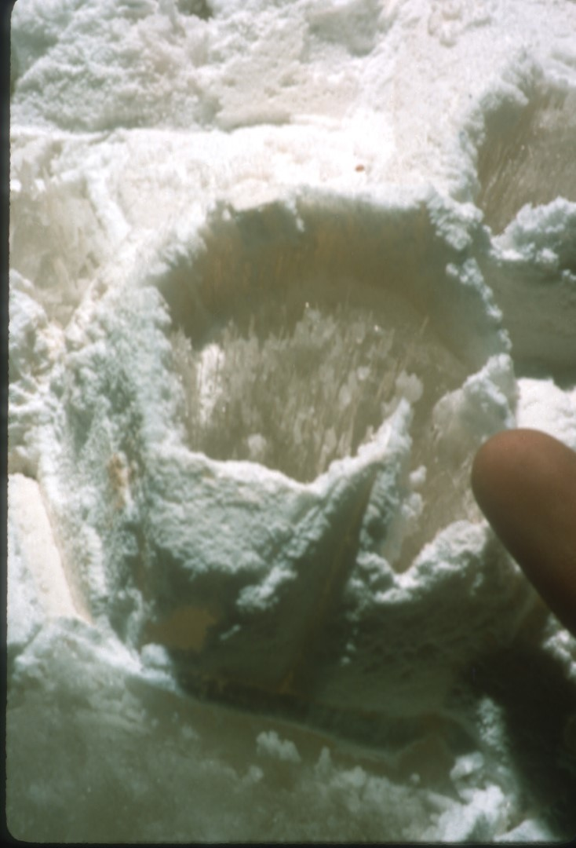
Notes:
Here is a very interesting example from a Utah cave. In the center of the picture is a large, six-sided nail head calcite crystal. This was formed when the chamber was filled with water. Now, under drier conditions, fibrous gypsum may be seen growing outward from the face of the crystal. The calcite crystal at this point is completely hidden by gypsum and only its shape betrays its presence.

Slide 9
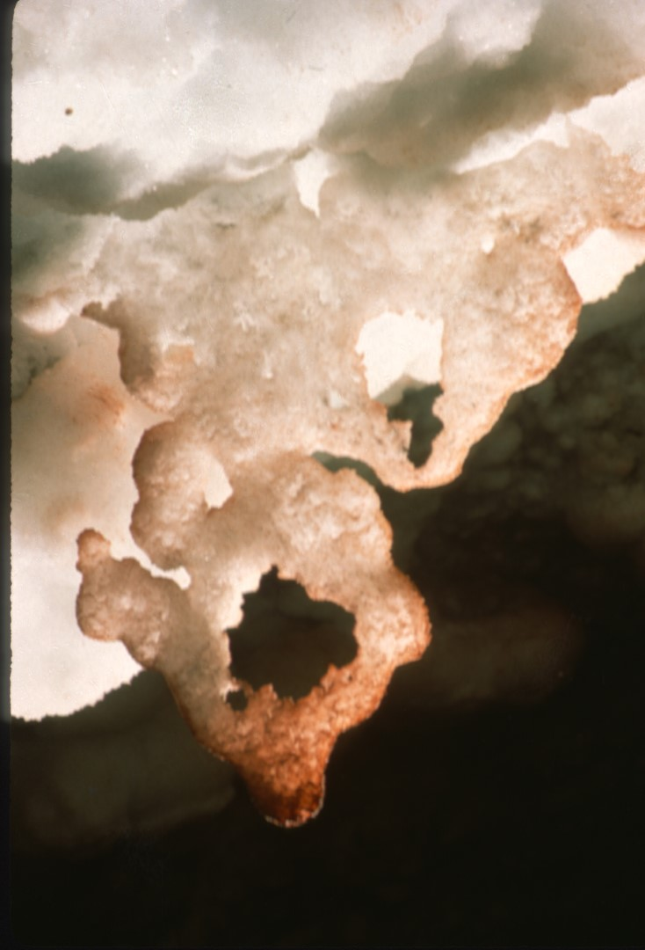
Notes:
A rarer form of gypsum speleothem resembling a crust is called a “rim”. Such rims form where warm, moist air emerges from a small hole into a room filled with cooler, drier air. Water condenses around the lip of the hole, and evaporation causes sulfate material to precipitate. Such rims are usually only a couple of millimeters thick and are extremely delicate.

Slide 10
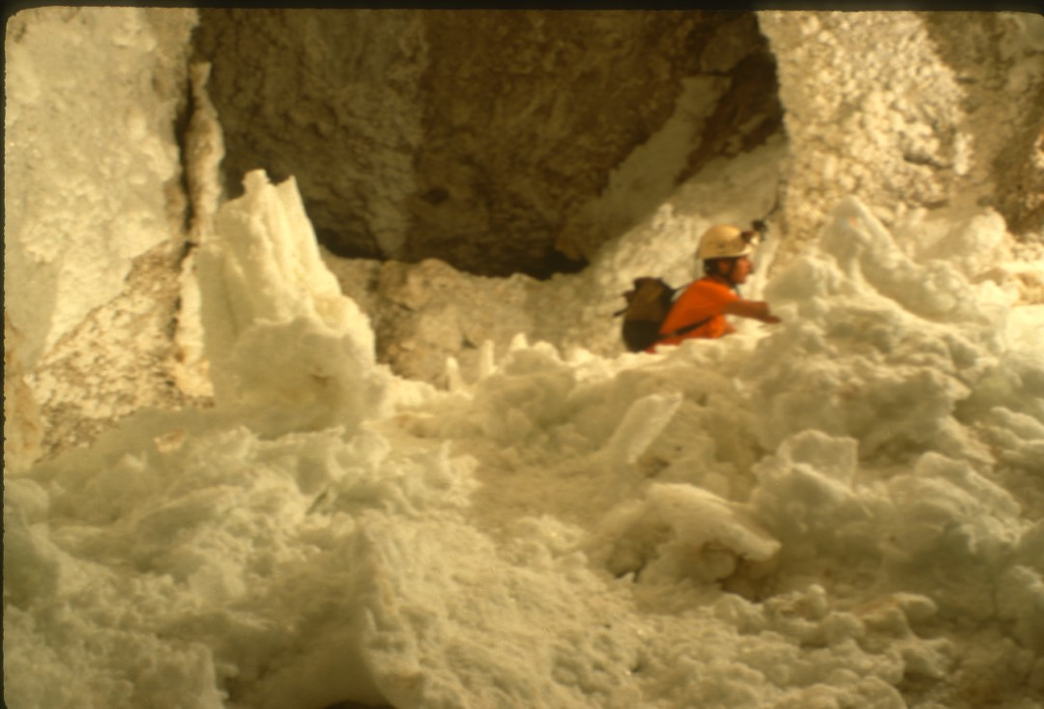
Notes:
Here are gypsum crusts gone wild, in Lechuguilla Cave, New Mexico. The crusts resemble great snowbanks and are feet thick in places. The powder on top is called “gypsum snow” and originated on the walls and ceiling the room.

Slide 11
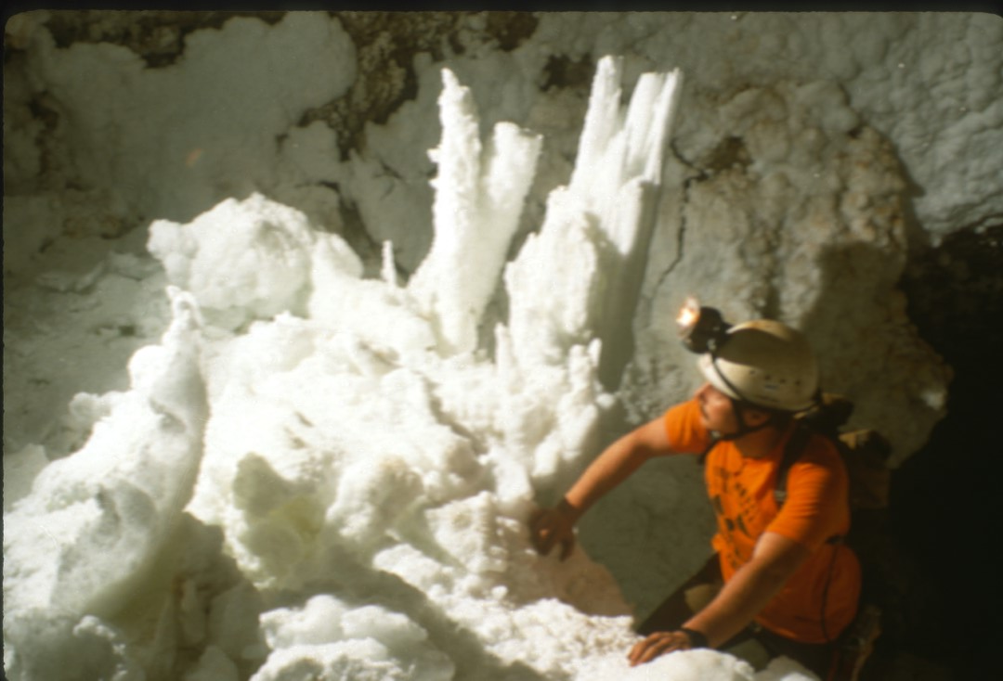
Notes:
In another shot from Lechuguilla, large gypsum crystals in the background have been completely covered with crusts and snow in a later phase of development.

Slide 12
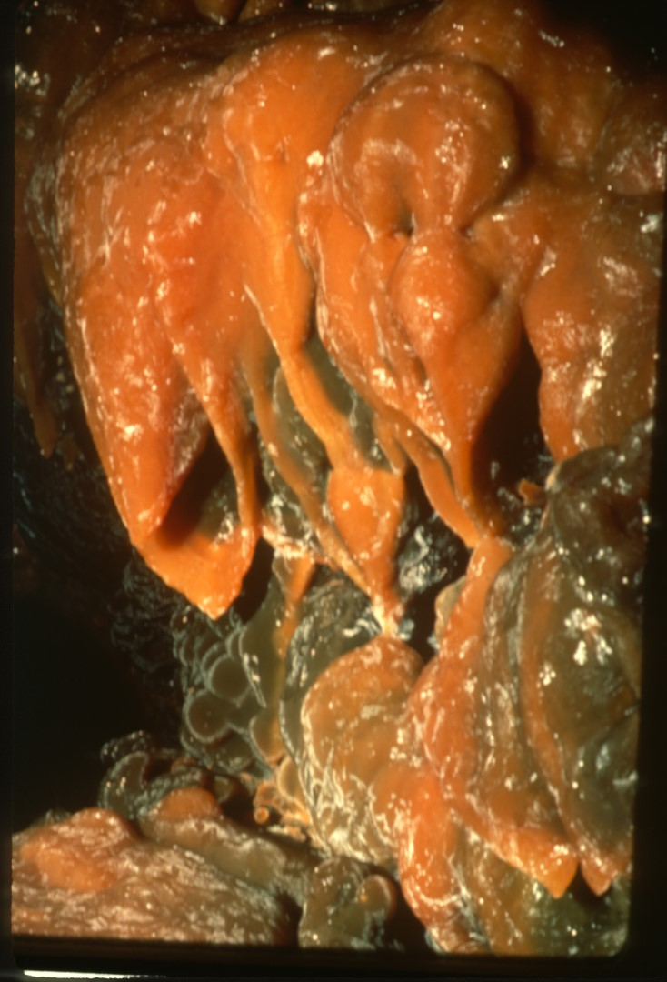
Notes:
In the previous examples, the crystals in the gypsum crusts were aligned perpendicular to the cave wall. Under different circumstances, gypsum crusts may form with the crystals parallel to the underlying wall. This example is from Fort Stanton, New Mexico.

Slide 13
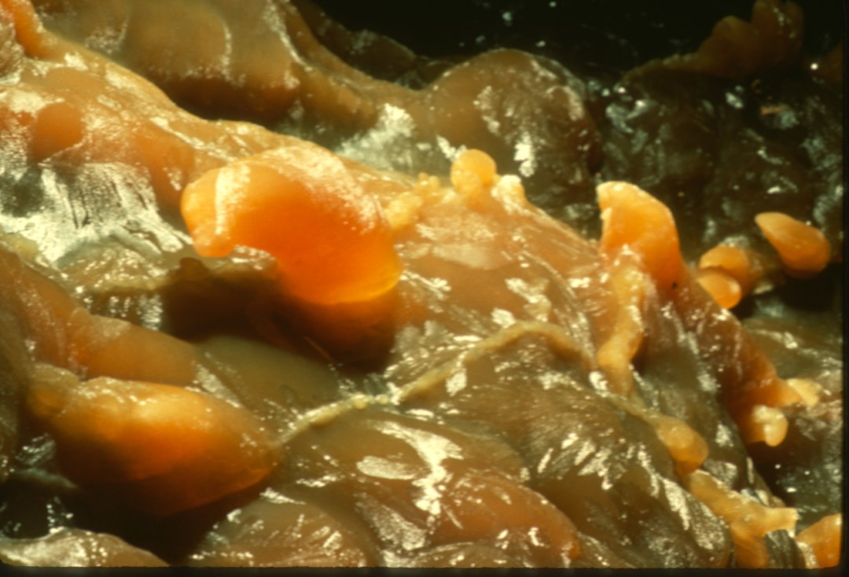
Notes:
More parallel-to-the-wall gypsum crusts from Fort Stanton include some gypsum “starbursts”. These occur when water seeps from a single hole rather than a number of evenly-spaced pores. The “starbursts” are sprays of gypsum crystals radiating outward from their source. These structures area not terribly obvious in this slide but may be glimpsed along the left margin.

Slide 14
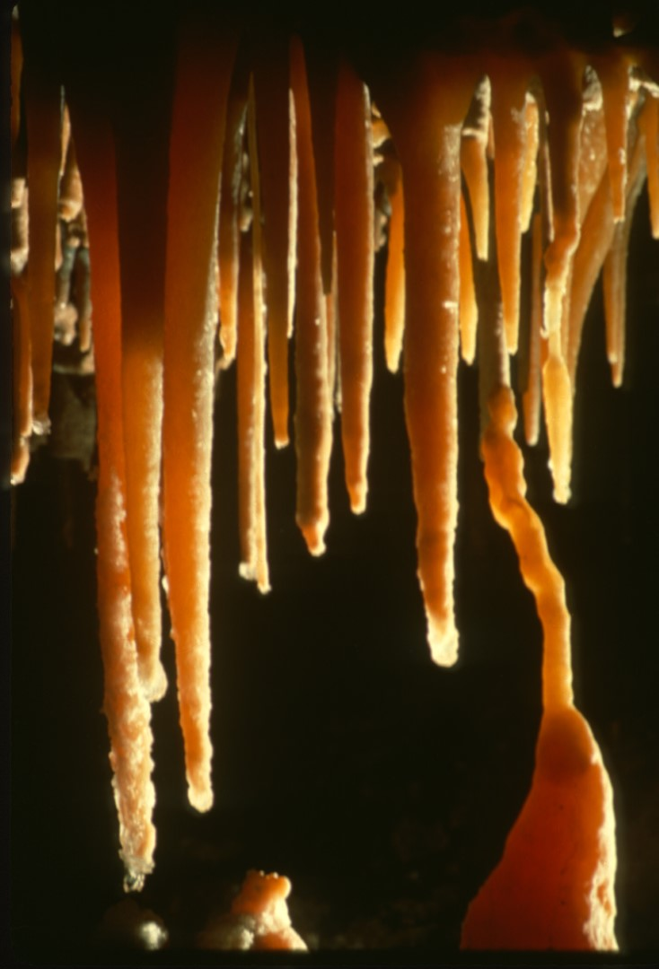
Notes:
Gypsum-bearing solutions have trickled along the outsides of these previously formed stalactites and have deposited clear gypsum near the tips.

Slide 15
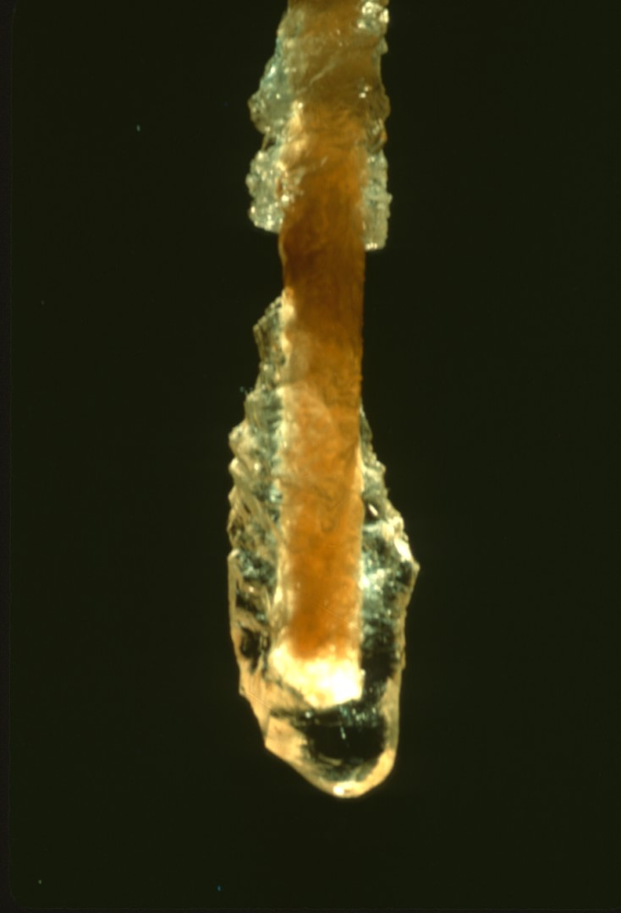
Notes:
This close-up shows a calcite soda straw which has been subsequently overcoated by a sulfate material, either gypsum or epsomite. Such dramatic examples are quite rare in caves, even in caves which show many other gypsum features.

Slide 16
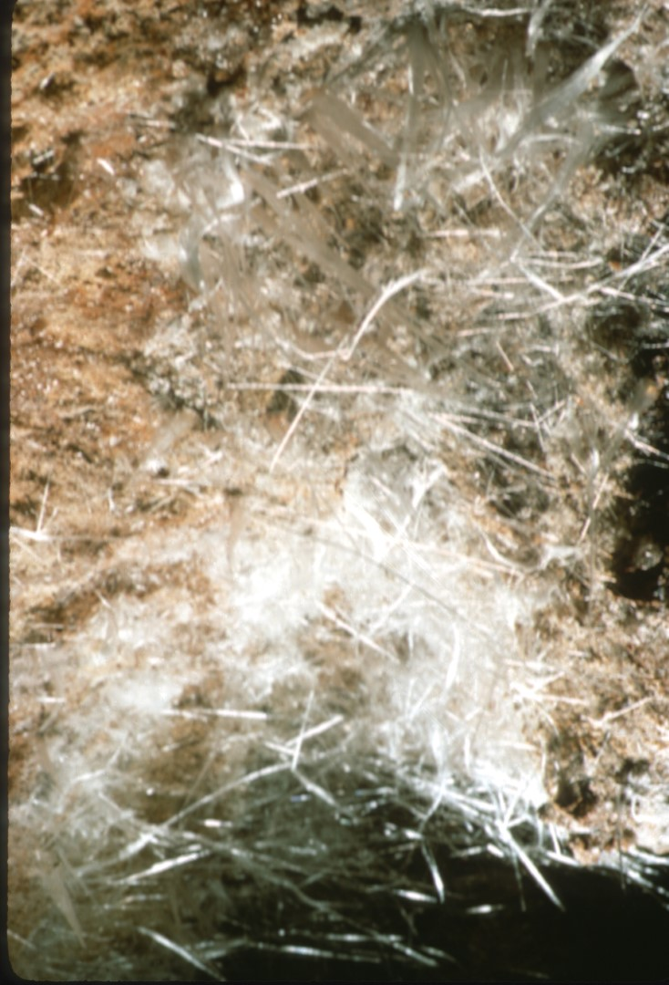
Notes:
Leaving crusts for the time being, let us examine another morphology known as “cave cotton”.

Slide 17
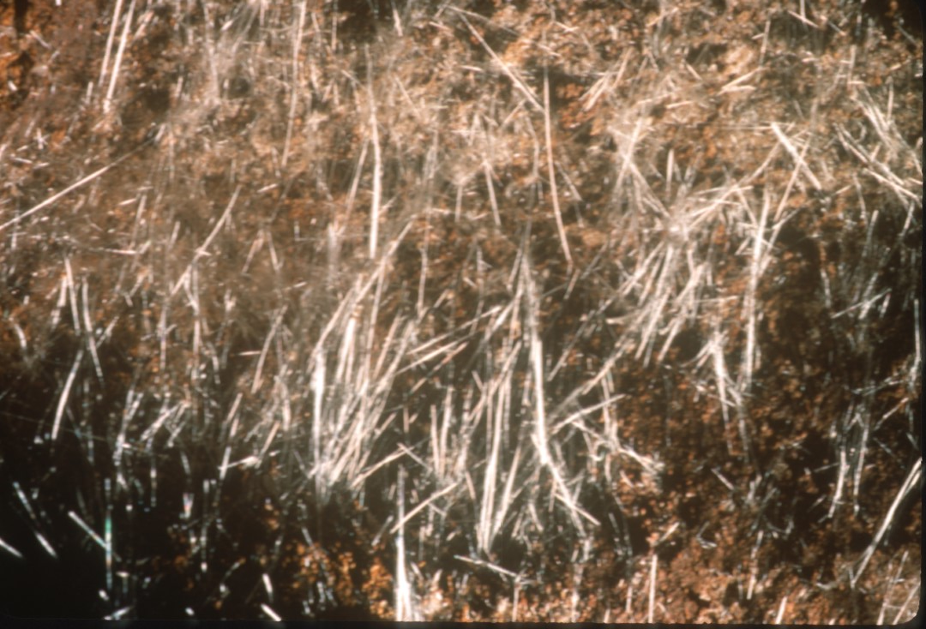
Notes:
Cotton is also known as “cave wool” or “beard”. These terms are used more or less synonymously . All contain short gypsum fibers matted together.

Slide 18
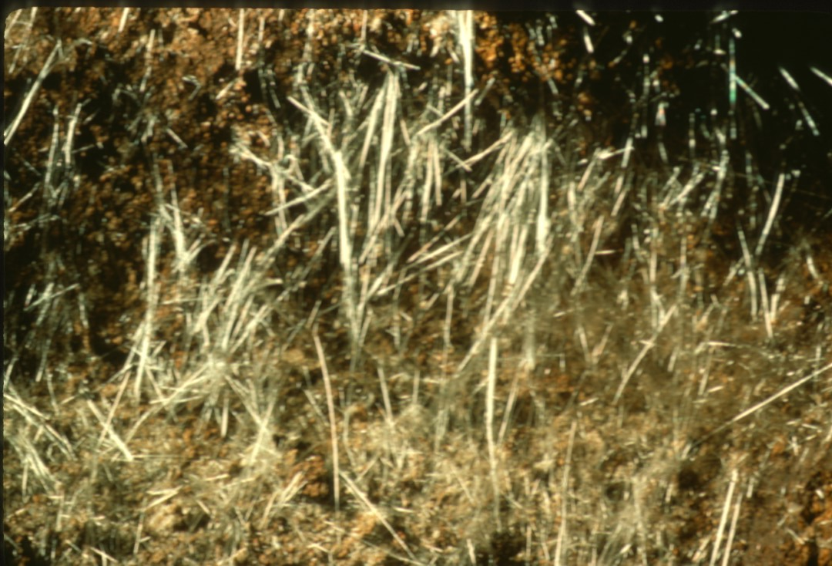
Notes:
All cave cotton grows into the air as new material is added from the base. Cotton is one of the fastest-growing speleothems and may grow millimeters per year.

Slide 19
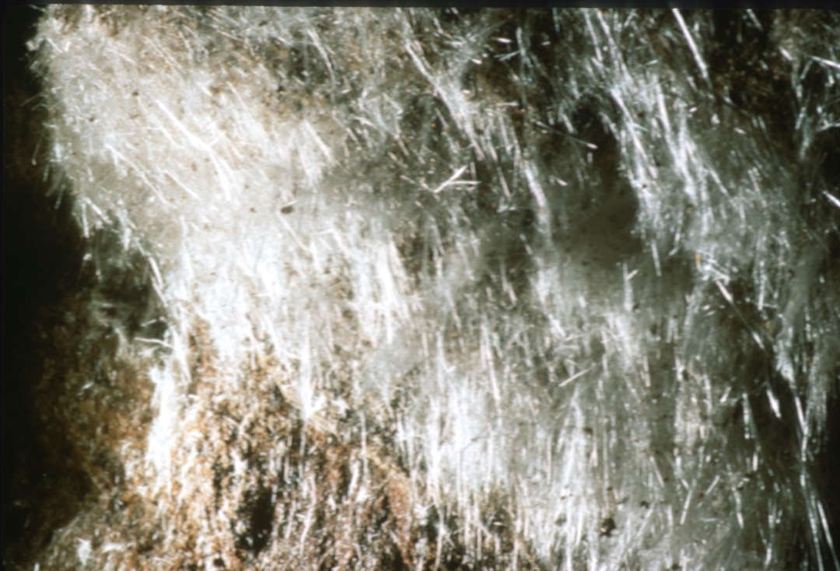
Notes:
This slide shows an unusually large mass of cotton or wool, woven into a virtual blanket.

Slide 20
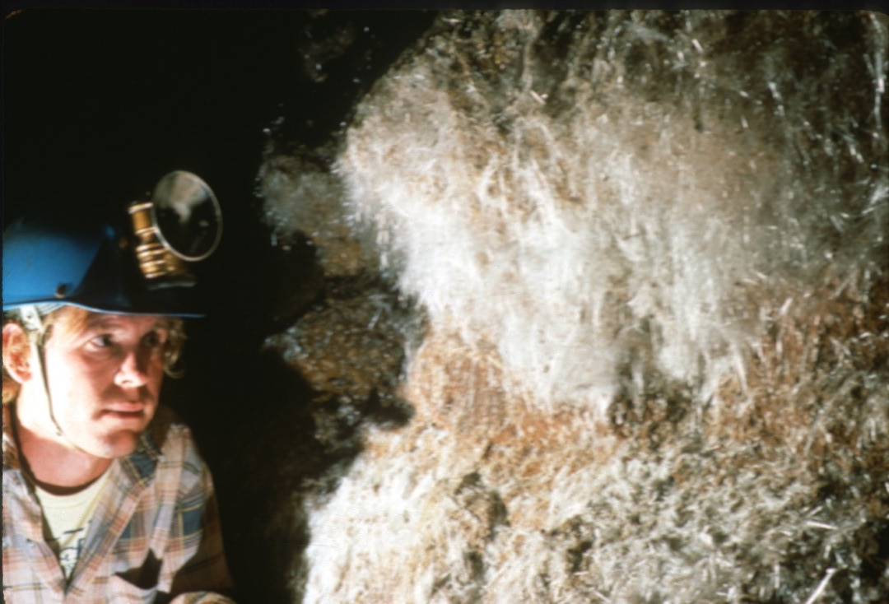
Notes:
A caver eyes the gypsum blanket but decides it would make poor material for a sleeping bag!

Slide 21
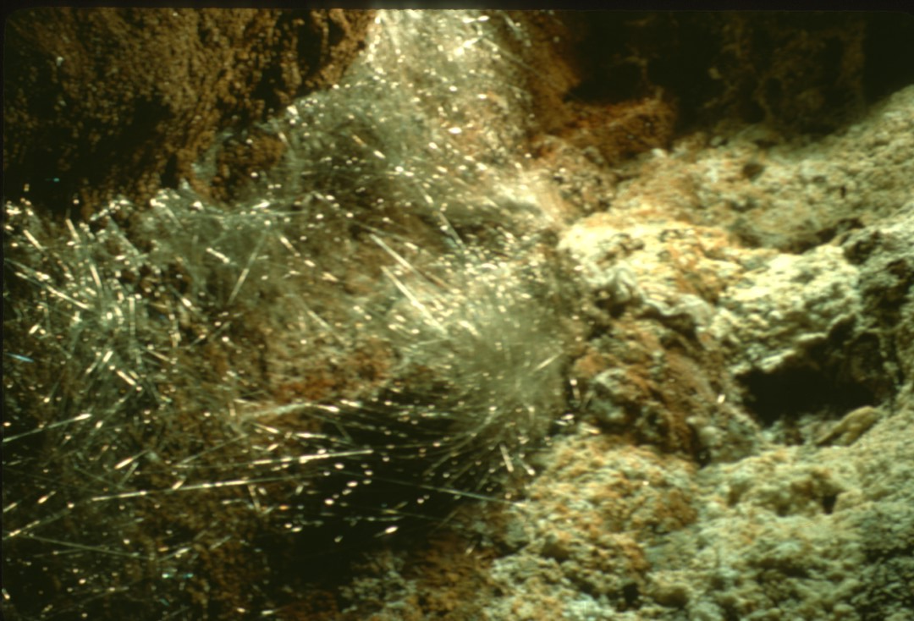
Notes:
A closely related phenomenon is called “angel hair”. This is one of the finest displays in the United States.

Slide 22
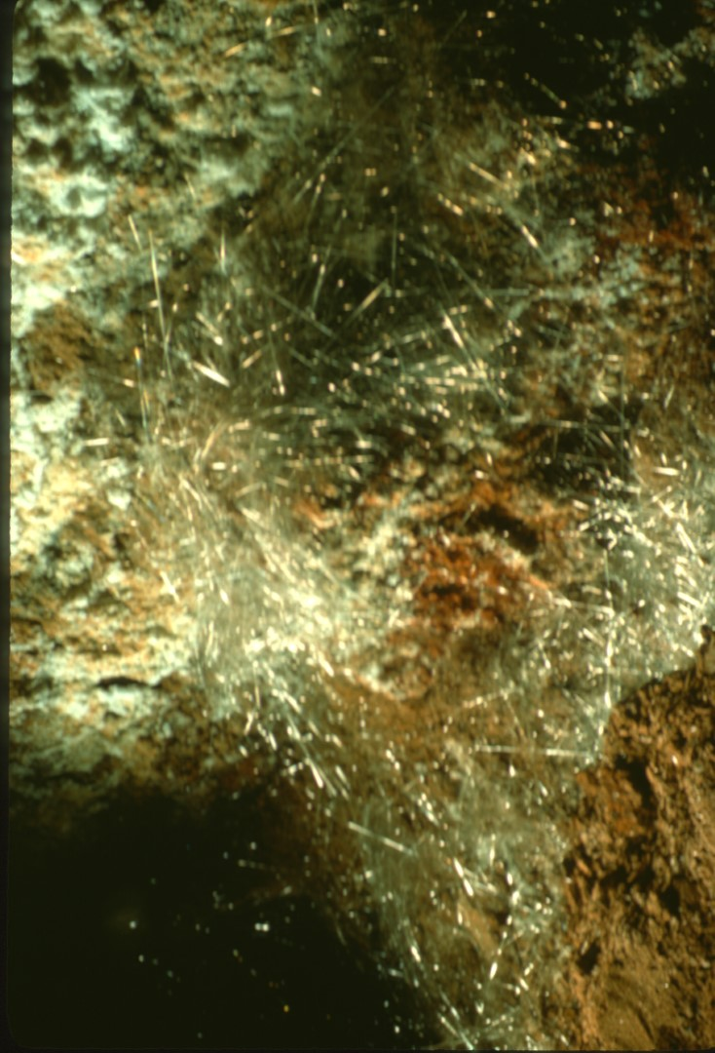
Notes:
Angel hair forms exactly the same way as gypsum cotton except that the fibers are far more elongated and better separated. Individual hairs may be feet long. Once again, formed from seeping water penetrating minute pores in fill or rock.

Slide 23
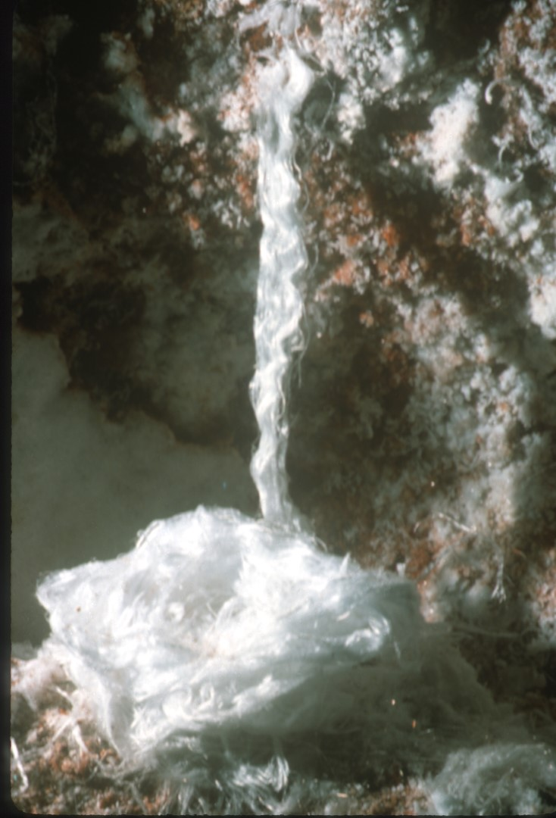
Notes:
A still rarer form of fibrous gypsum is called “rope”. This slide depicts what is probably the finest example in the U.S. In a cave rope, parallel strands of gypsum fibers are arranged to closely resemble a cord. This rope has apparently deposited over twenty turns on the underlying ledge!

Slide 24
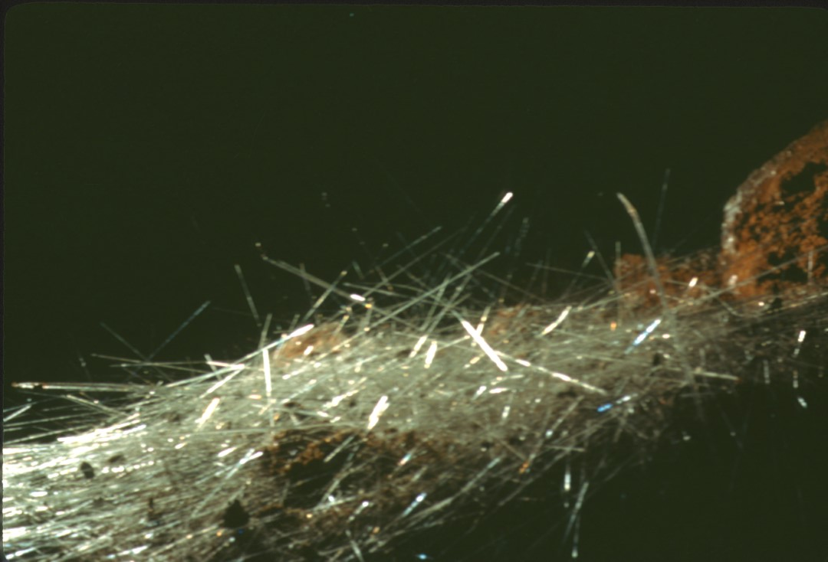
Notes:
One of the best-known forms of cave gypsum is the “gypsum needle”. They may occur singly, or more commonly in piles like jackstraws, as shown here.

Slide 25
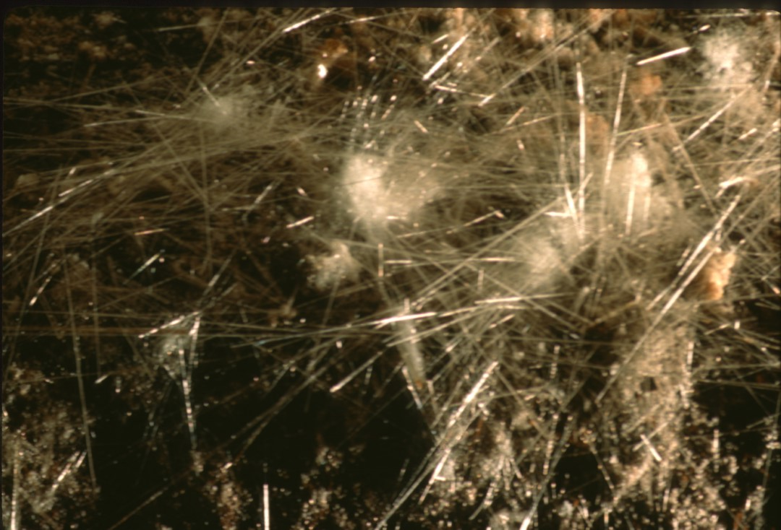
Notes:
This picture shows needles combined with tufts of cave cotton, already discussed. Needles and cotton have a similar origin. One would suppose that the seeps and pores responsible for the needles are larger than those of the cotton.

Slide 26
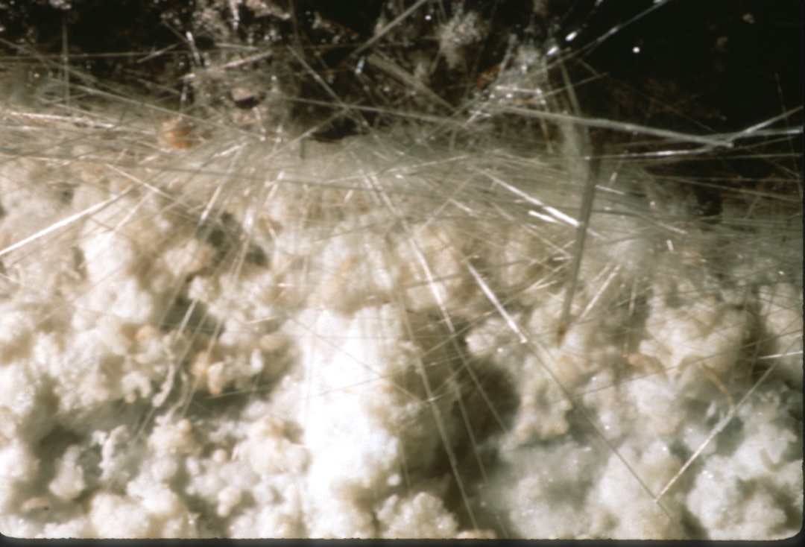
Notes:
Here are four different forms of cave gypsum morphology within a very small area in a cave in Arkansas. A gypsum crust coats the background wall, sprinkled with a few tiny gypsum flowers, to be discussed later in this program. In the foreground are needles and cotton. All of these speleothems were formed by seepage, with slightly differing conditions producing markedly different forms of the same mineral. Gypsum is truly a fascinating cave mineral!

Slide 27
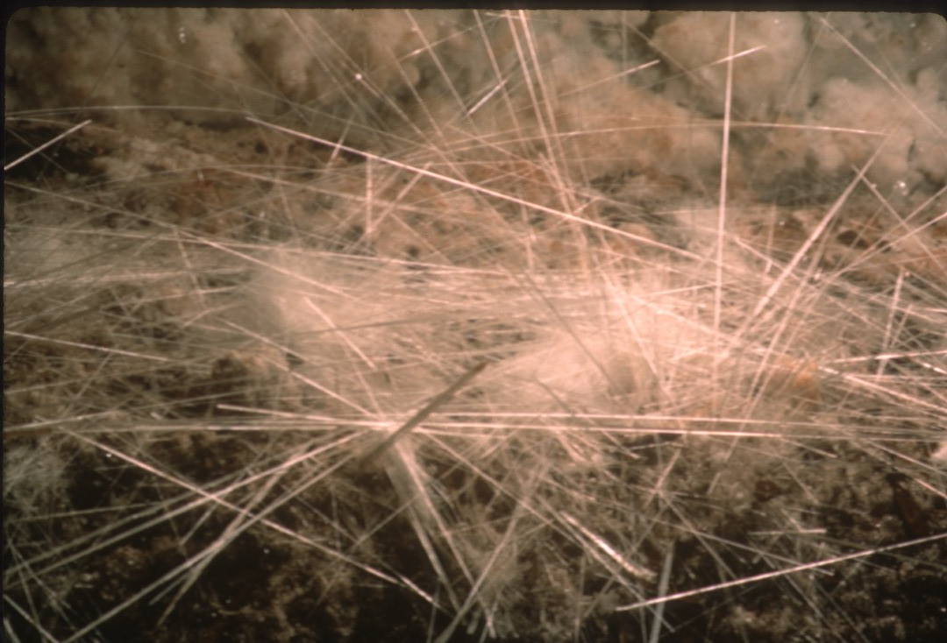
Notes:
Cave needles may grow up out the floor at any angle. When they grow long enough, they commonly topple over from their own weight. A new needle will begin growing in the same hole. As this process continues indefinitely, the cave floor may almost disappear from view. Needles may be very slender, approaching angel hair, or –

Slide 28
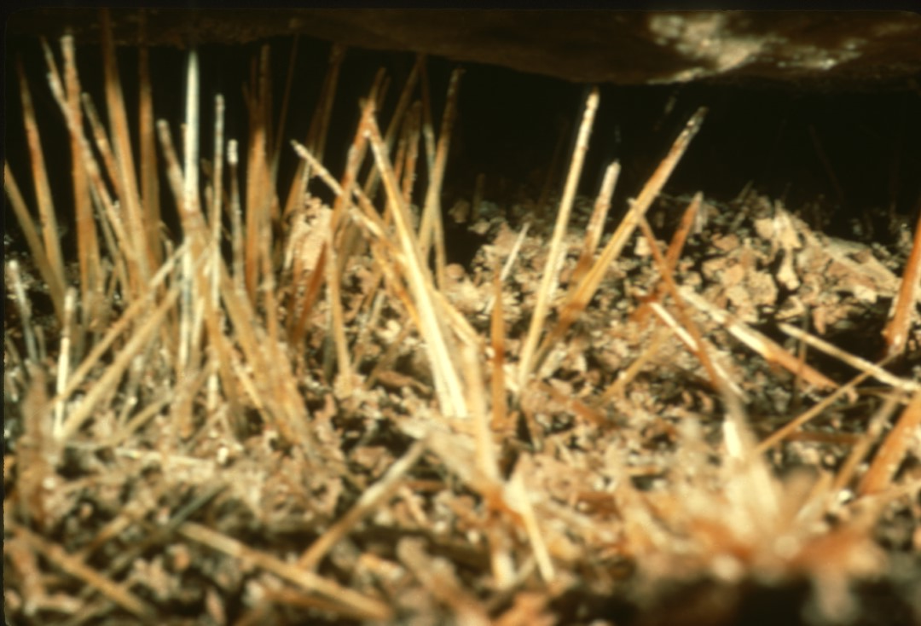
Notes:
They may be relatively short and stubby, almost pencil-like in appearance. It is obvious from this picture that they may also be stained by impurities, though they are most often white to transparent.

Slide 29
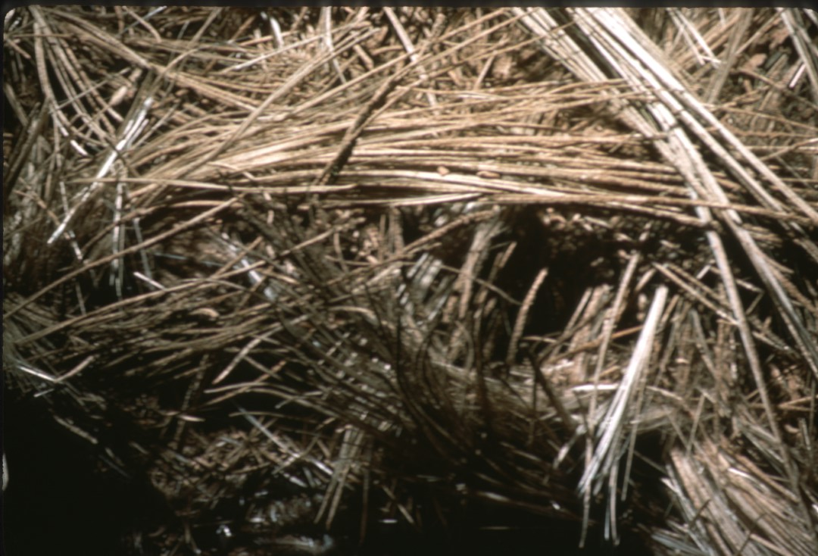
Notes:
Closely related to gypsum needles, but strikingly different, is “gypsum grass”. It has been observed in only one cave in the world to date.

Slide 30
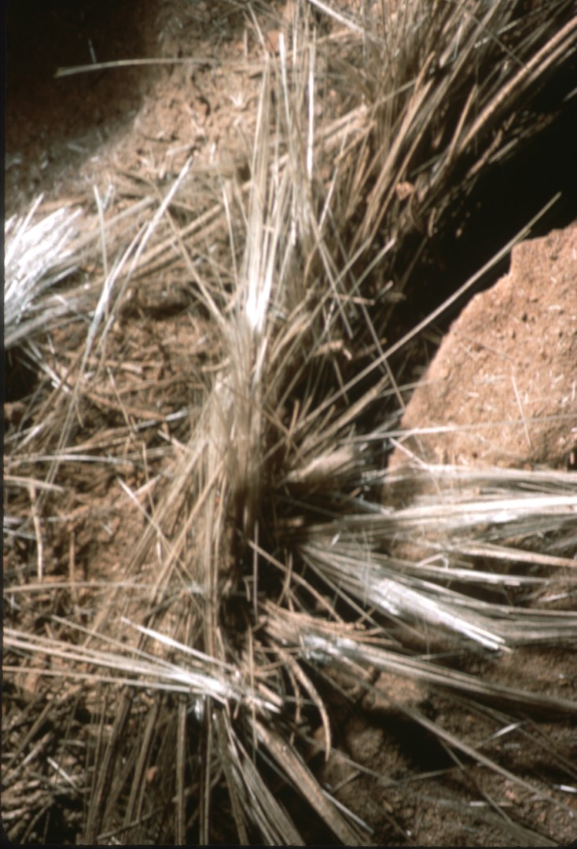
Notes:
Gypsum grass occurs as swirls of intertwining selenite needles. The average grass blade length is about fifteen inches though some approach two feet in length. Each tuft of “grass” has about thirty to forty needle swirls. The gypsum-bearing water percolated through the cave soil.

Slide 31
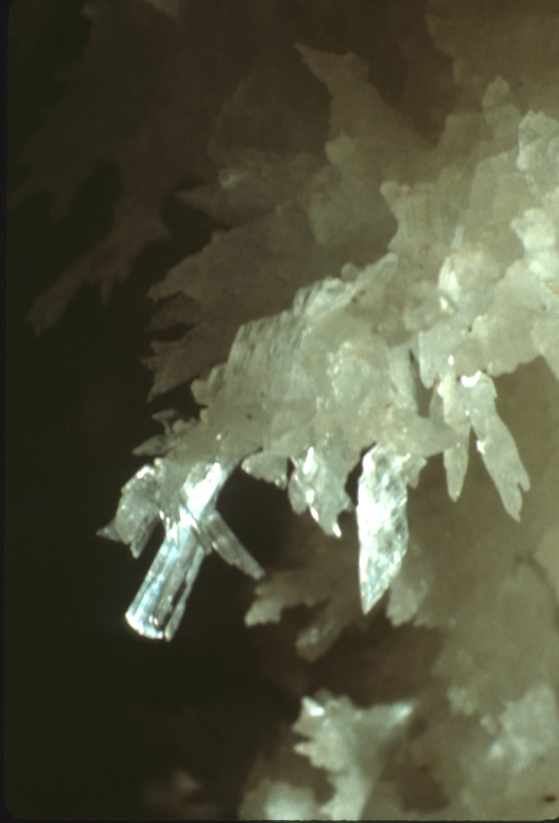
Notes:
In addition to the various needle and hair forms, sub-aerial gypsum may grow in what is called tabular form. Tabular gypsum crystals are much blunter than needles but are still due to seepage.

Slide 32
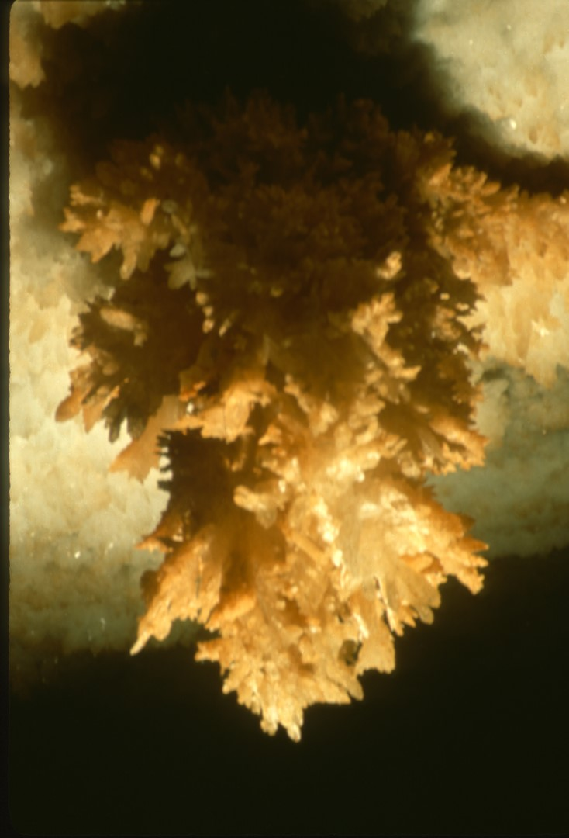
Notes:
Tabular gypsum may grow in crystal bushes. This bush is inverted and is growing on the ceiling in Fitton’s Cave, Arkansas. Its overall length is about nine inches. Note the brown staining, while the background gypsum crust is largely white.

Slide 33
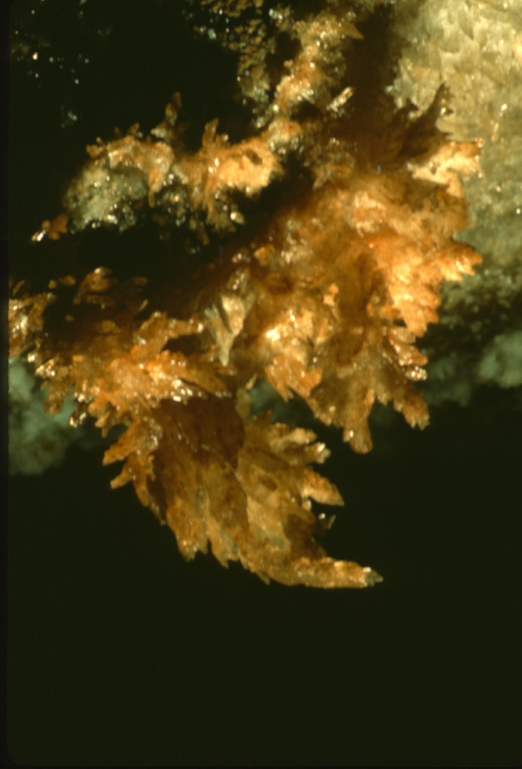
Notes:
It is believed that larger tabs grow under conditions of high humidity. Repeated twinning of the crystals in this tabular bush led to the curved appearance.

Slide 34
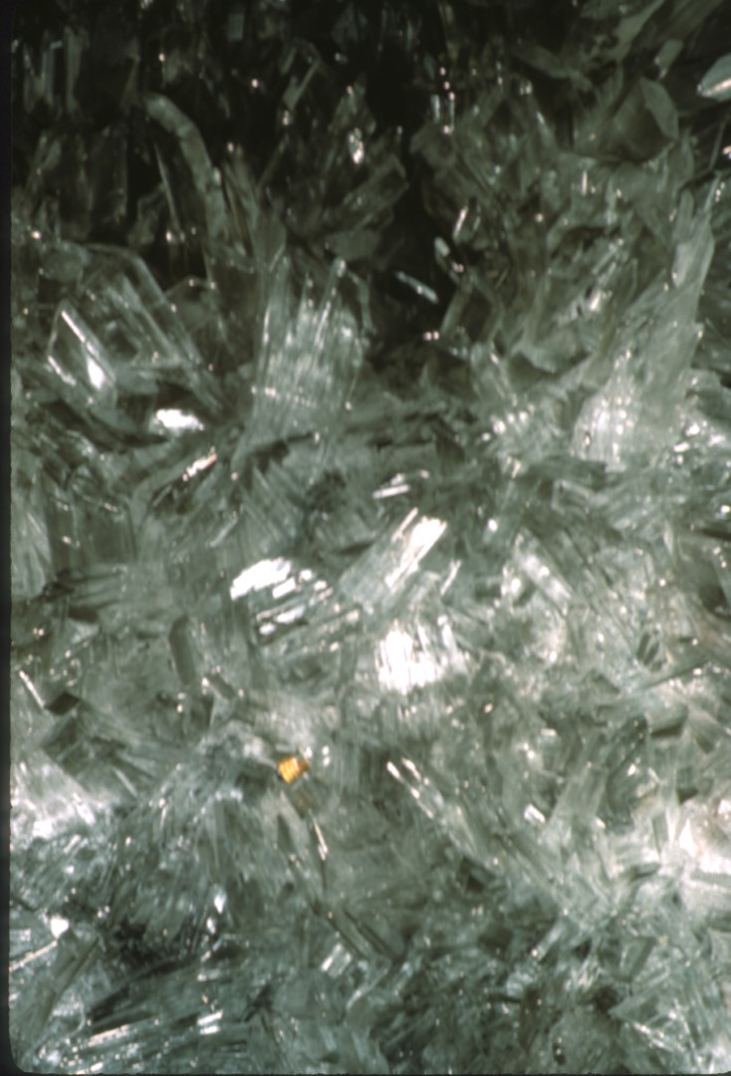
Notes:
In contrast to the previous slides, all of which show gypsum forming in air, we will now examine some subaqueous growths of gypsum, which in general are much less commonly observed by cavers. This slide shows some curved, prismatic crystals of gypsum with a flashlight bulb for scale. This slide was taken in a cave in a mine in Mexico. When these crystals formed the chamber was beneath the water table.

Slide 35
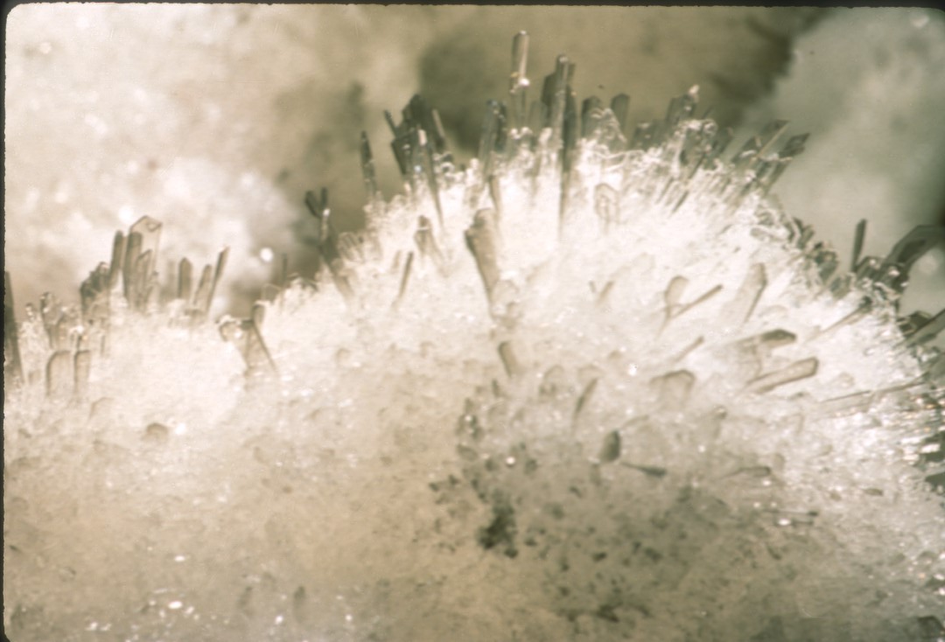
Notes:
Note the remarkable resemblance of these subaqueous gypsum crystals to Roman gladiator’s swords. They are, in fact, exact miniature replicas of the gigantic swords growing in the same room. These tiny swords are only a few millimeters long.

Slide 36
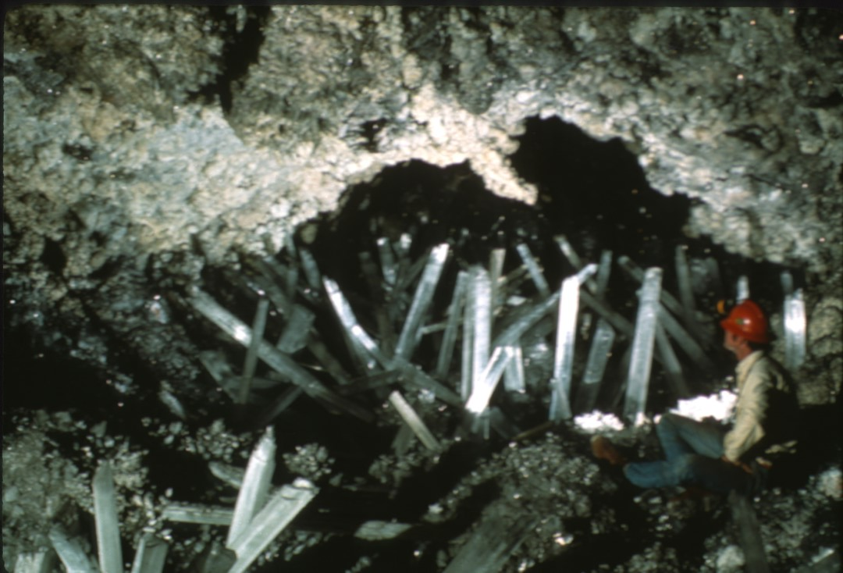
Notes:
One of the most awe-inspiring sights in the underworld, a chamber filled with huge, transparent gypsum swords. While superficially resembling giant gypsum needles, it must be remembered that these swords grew while totally submerged in a supersaturated solution of gypsum, not in the air like the needles.

Slide 37
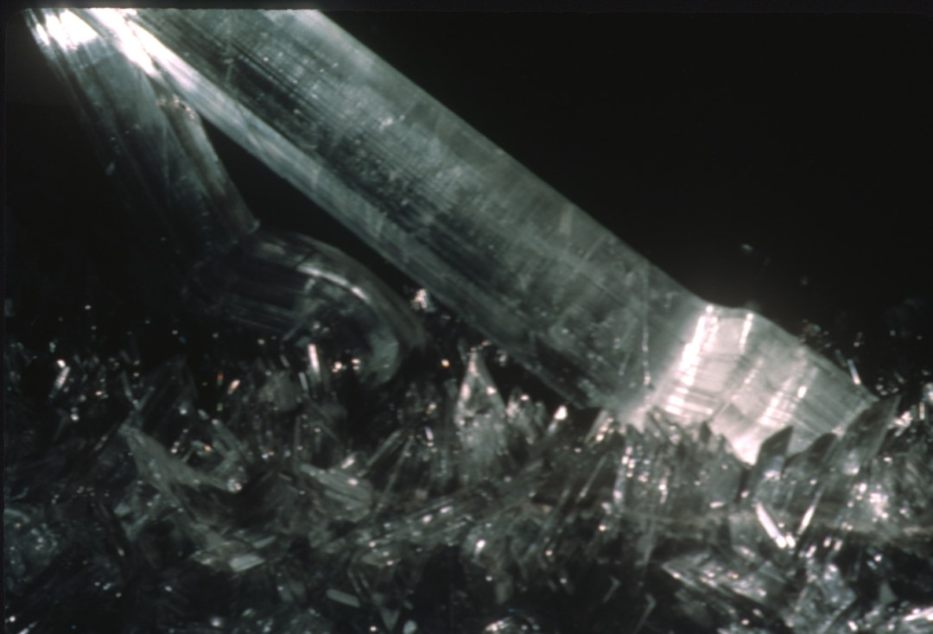
Notes:
Gypsum crystals may be easily bent without breaking in a direction perpendicular to the long axis. These two great swords grew until they ran into the cave wall, then began to bend as they attempted to grow farther. About two feet of the longer sword is shown.

Slide 38
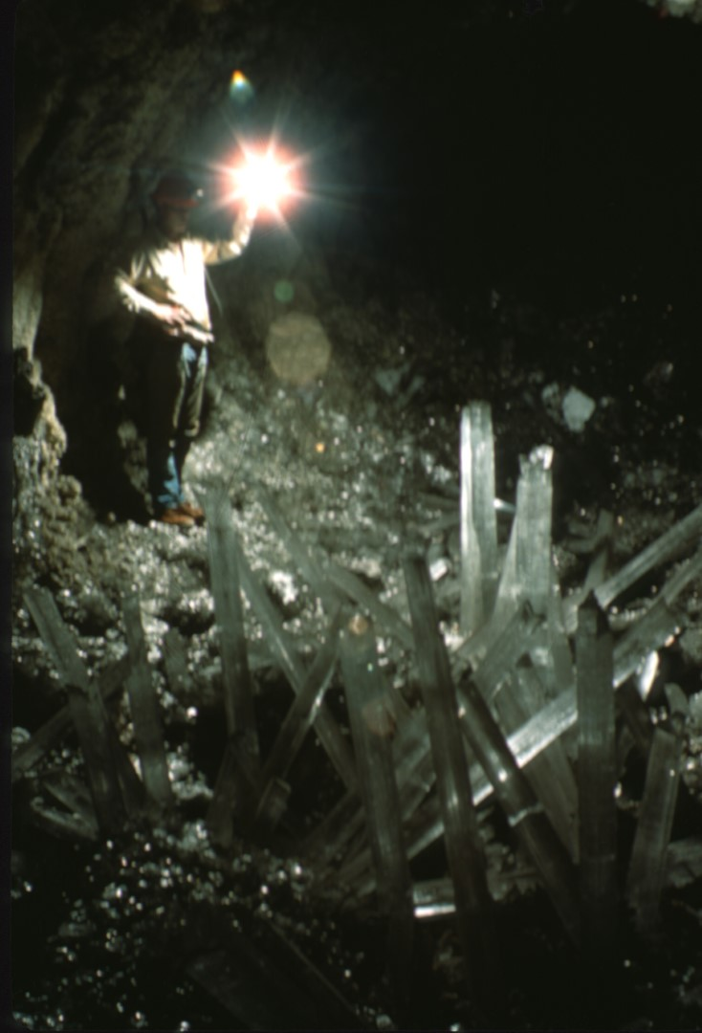
Notes:
One last look at what is probably the worlds’ finest display of gypsum swords in a cave. The photographer has heard that since these photos were taken, all the swords were quarried out and sold to collectors and museums. This rumor is so depressing he has not cared to investigate it further.

Slide 39
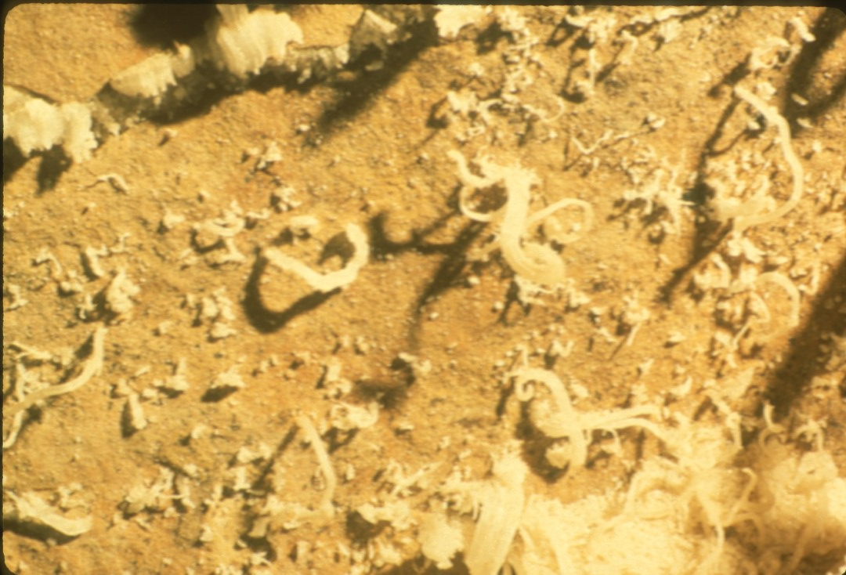
Notes:
Gypsum flowers are among the most admired of cave formations. Flowers are composed of branching and curving bundles of gypsum crystals loosely packed together in a polycrystalline matrix. These flowers are at the small end of the scale, all under an inch long.

Slide 40
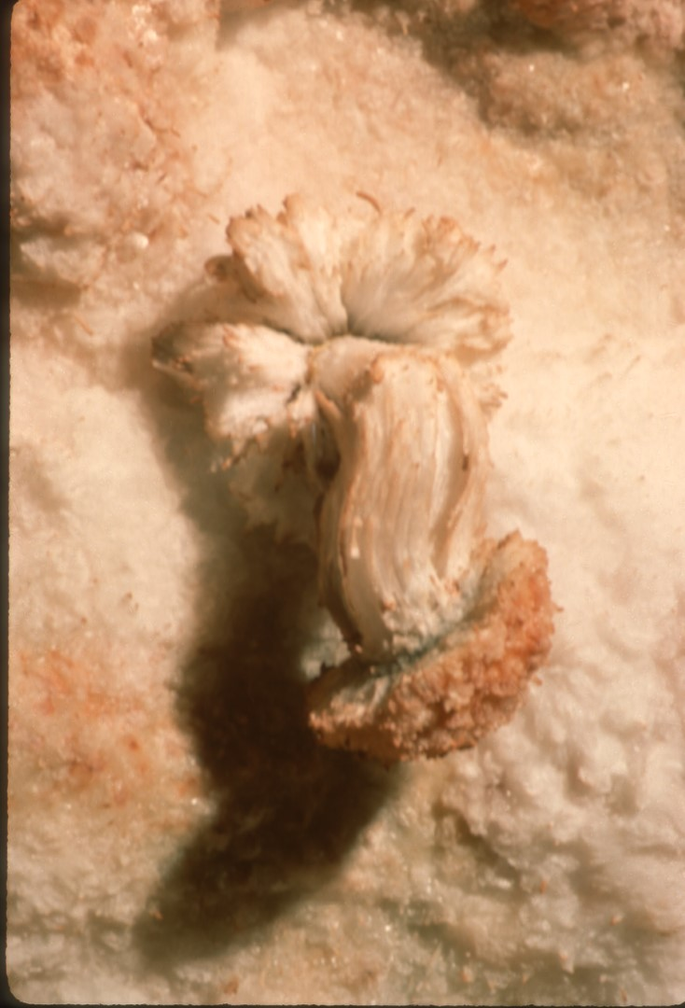
Notes:
Here is a “mushroom” type flower, about four inches long. The first solutions issuing from the cave wall deposited uniformly over the cave all as a crust. Later, more localized growth associated with a pore began the growth of a flower. This had sufficient force to break through the earlier crust and carry along a fragment of it with it. One cannot help but be reminded of spring flowers pushing up dirt ahead of them as they sprout.

Slide 41
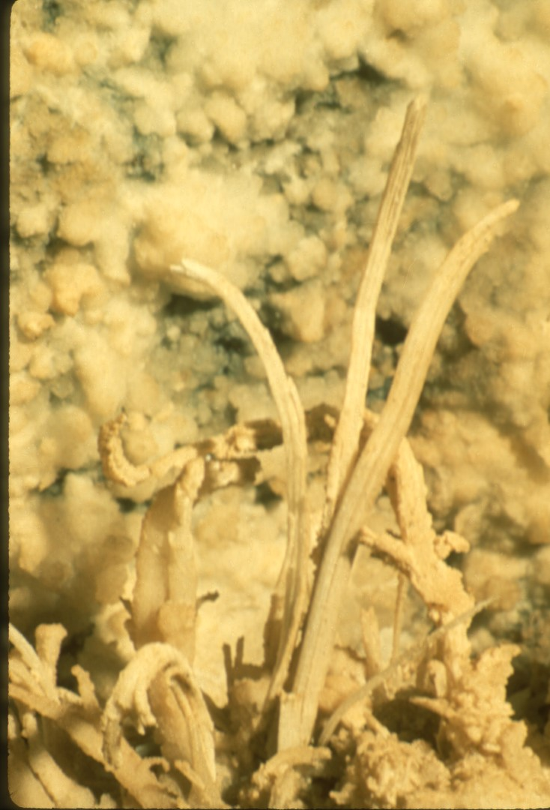
Notes:
Generally, growth on one side of the flower will be stronger than the other, and graceful curves result. Much less commonly, growth will be nearly uniform and long, straight “petals” may result. The three in the center of this picture are almost a foot long.

Slide 42
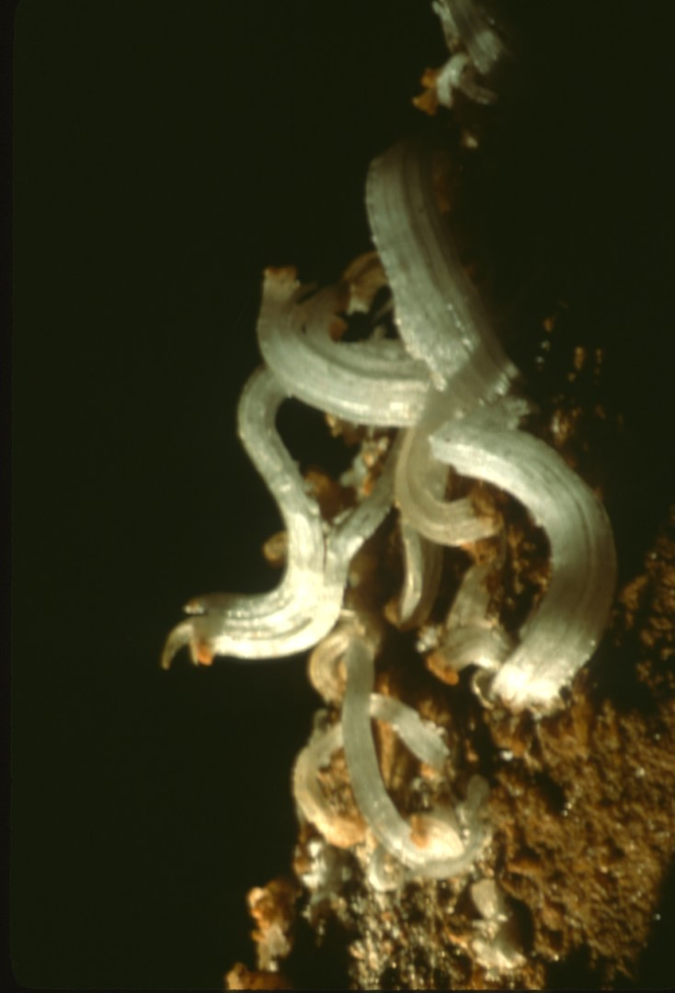
Notes:
While gypsum flowers seem to grow most often from walls and ceilings of caves, they can appear anywhere and seem to pay little attention to gravity. These are growing on a ledge in Fitton’s Cave, Arkansas.

Slide 43
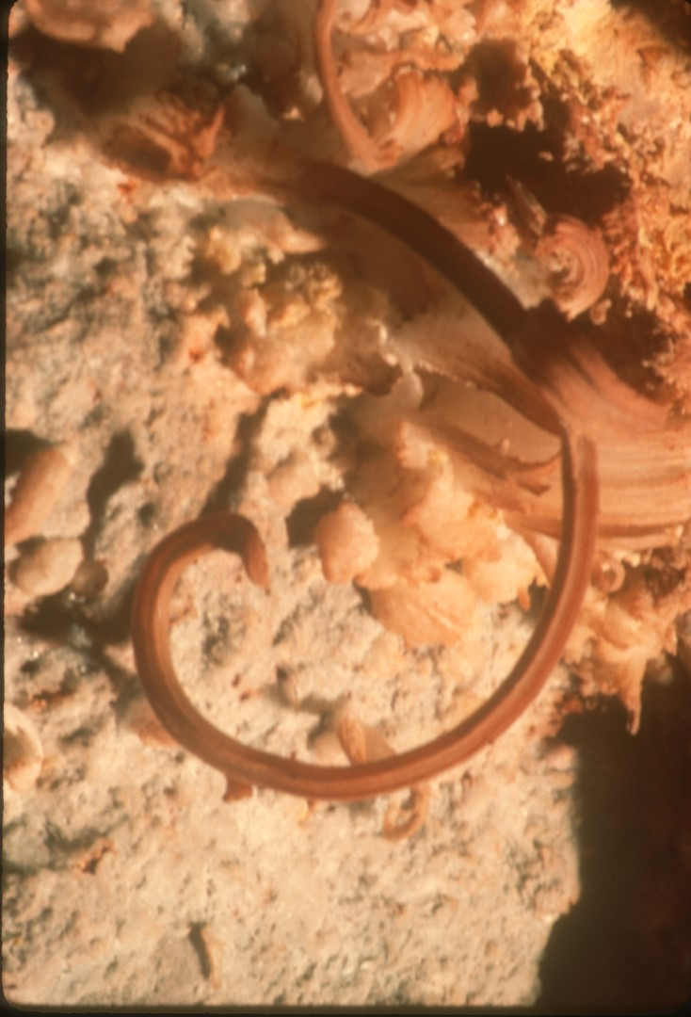
Notes:
Here is a classic, curved gypsum flower suggesting a butterfly tongue. This is in a cave in the Grand Canyon of Arizona.

Slide 44
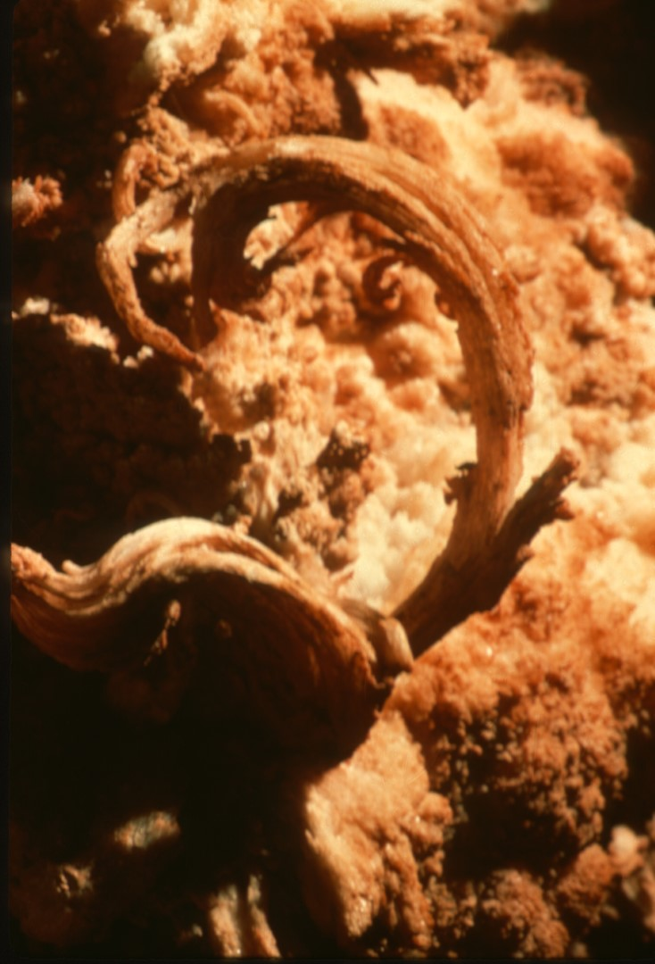
Notes:
Note that while gypsum flowers are usually, white, they may be heavily iron-stained.

Slide 45
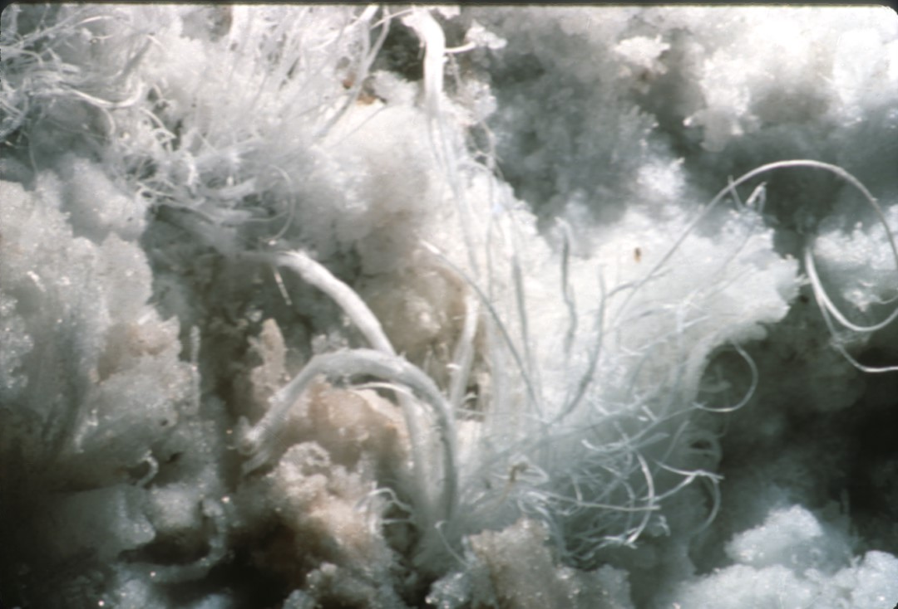
Notes:
While some gypsum flowers may be rough and shaggy in appearance, others astound you with their delicacy. The petals of these gypsum flowers are not much thicker than kite string and are the thinnest the photographer has observed.

Slide 46
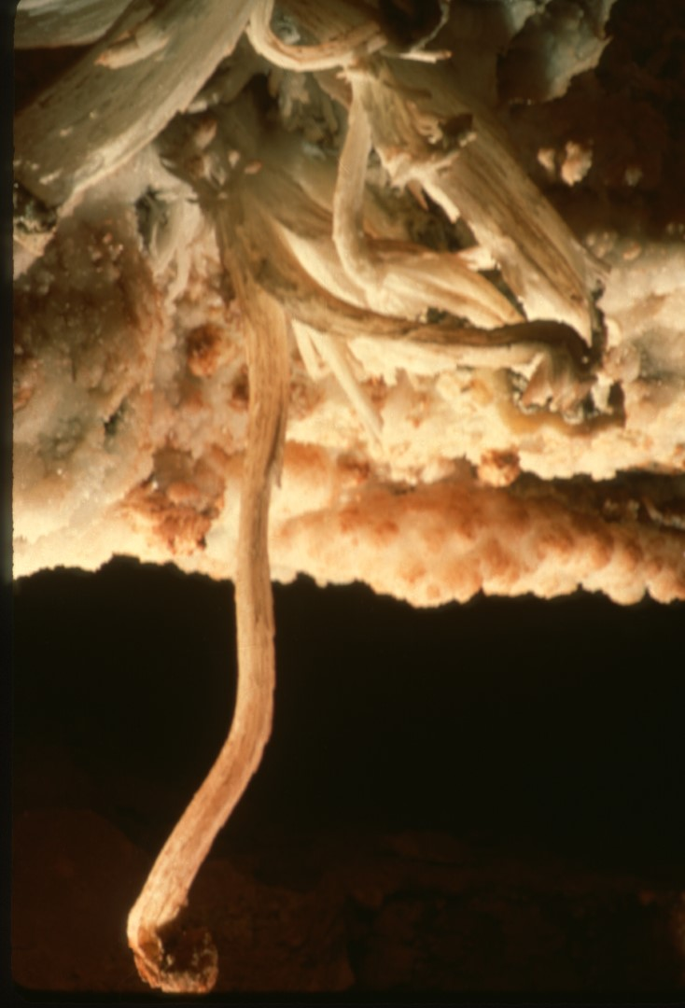
Notes:
Here is an exceptionally long gypsum flower, over fifteen inches long. Note the mushroom cap still on the tip, a remnant from when it first thrust through the overlying crust. How long ago do you suppose that was? The photographer has seen no data documenting growth rates for such flowers.

Slide 47
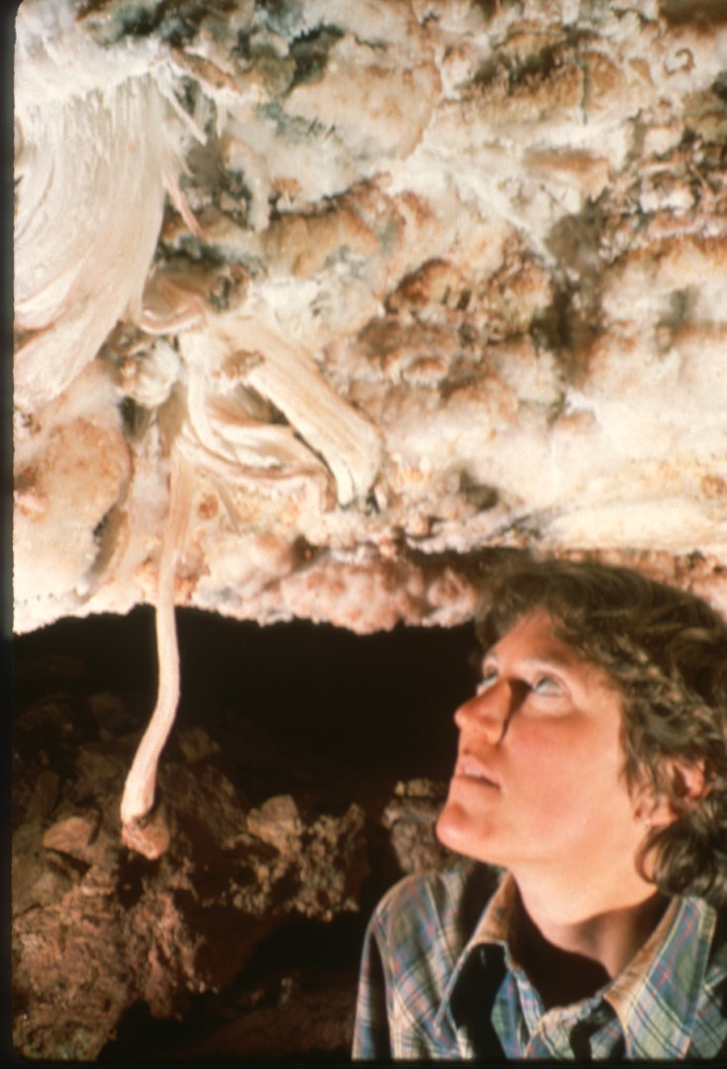
Notes:
This caver observed the flower intently for as long as her cramped neck muscles would allow but could detect no growth. Evidently more patience is required than most cavers possess!

Slide 48
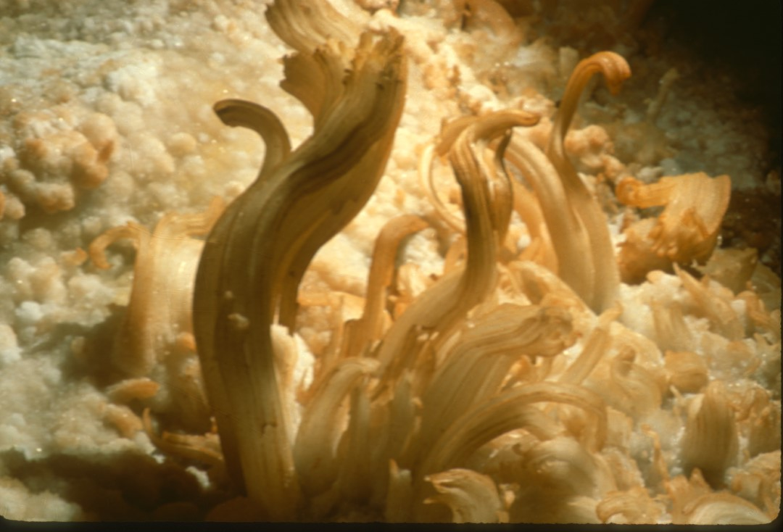
Notes:
The largest of these waxy-looking, yellowish flowers is over a foot long and dangles from a cave wall which is inclined at about forty-five degrees. Such thick flowers are sometimes called “ram’s horns”.

Slide 49
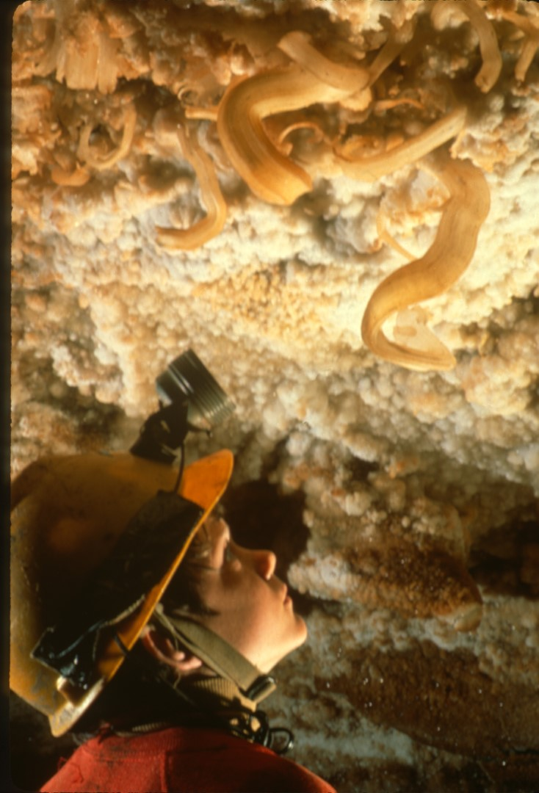
Notes:
Here is Nelson Day observing some outstanding ram’s horns in Fitton’s Cave, Arkansas.

Slide 50
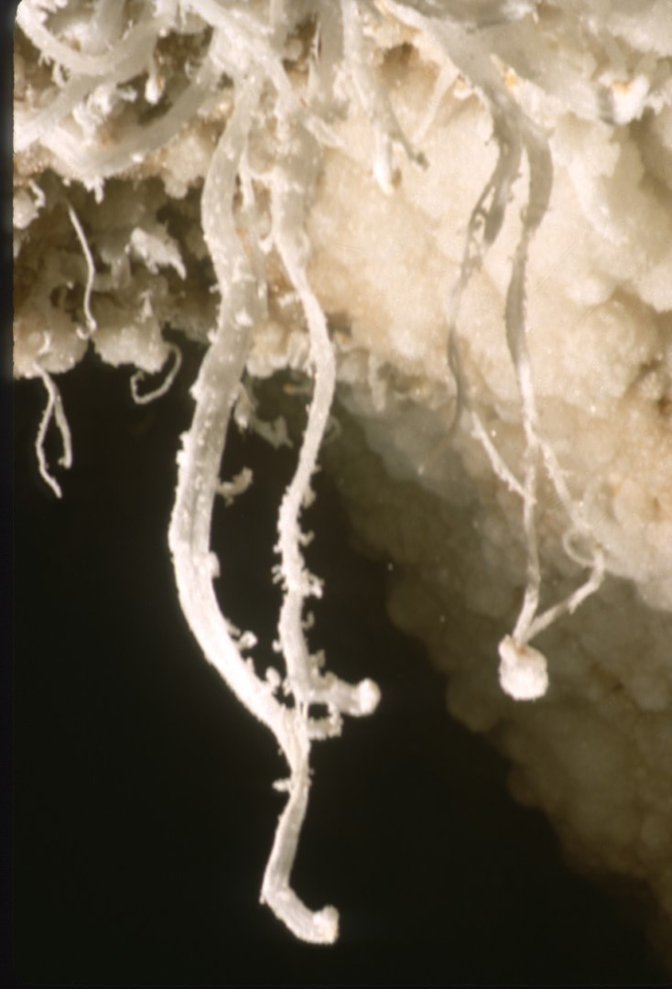
Notes:
While other caves contain more massive flowers, some of the most beautiful in the United States were discovered in January of 1988 in Lechuguilla Cave, New Mexico. These wonders dangle about eight inches long.

Slide 51
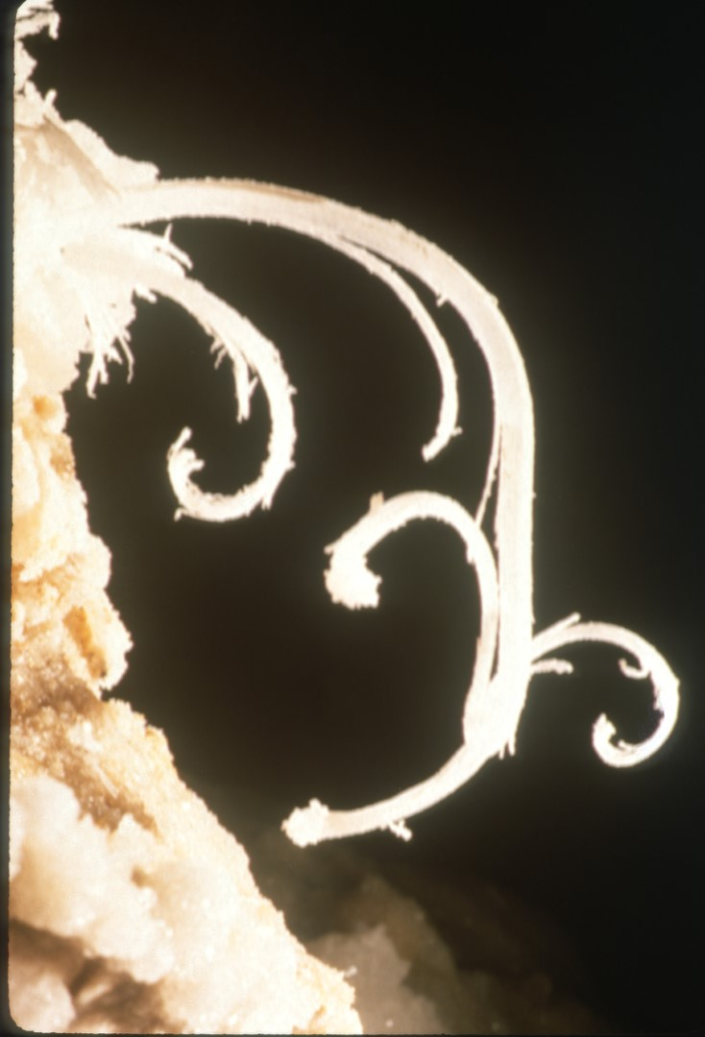
Notes:
And God said, “Let beauty appear amidst the darkness…,” and His words were recorded in crystal.

Slide 52
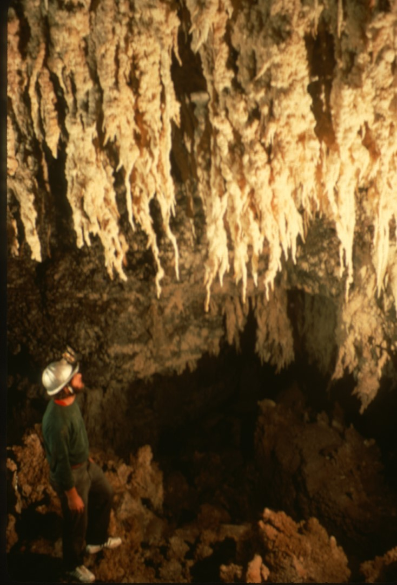
Notes:
We will now visit the weird world of gypsum stalactites and stalagmites. Gypsum stalactites will barely resemble the more familiar calcite ones. They consist of coarse, porous, unoriented grains. They generally look like coated tree roots.

Slide 53
Notes:
This great room in Torgac Cave, New Mexico, is one of the classic localities. Sulfate solutions dripping off the ceiling and gypsum stalactites have formed numerous gypsum stalagmites as well.

Slide 54
Notes:
Gypsum stalactites do not usually maintain a central canal, but grow primarily by water flowing down their sides. “Claw” shapes form when end crystals grow large and new growth deviates from the vertical.

Slide 55
Notes:
Here is a famous pair of gypsum claws called, appropriately enough, “The Chicken Feet.” The feet are quite large, about three feet long. They hang high overhead, so it is not possible to include scale.

Slide 56
Notes:
Here is a remarkably sharp claw stalactite ensemble. The breakdown blocks in the background are covered with gypsum which appears heavily resolutioned. Apparently, non-saturated ground water invaded this chamber for a time and dissolved away some of the previously deposited gypsum.

Slide 57
Notes:
The final form of gypsum to be shown in this series is the so-called “chandelier.” These were discovered in January of 1988 in Lechuguilla Cave, New Mexico. The chandeliers are magnificent clusters of gypsum stalactites, and some stalagmites as well. The tips of each chandelier are characteristically covered with crystal-clear selenite prisms.

Slide 58
Notes:
Here is the largest chandelier growing upward from the floor. Despite their great size, the chandeliers must have grown by seepage through the floor and ceiling of the chamber.

Slide 59
Notes:
The magnitude of the display can best be appreciated by this shot taken farther back. The tops of the chandeliers are covered with the purest white gypsum snow. As mentioned before, the tips are often clear selenite prisms, heavily twinned and striated. This same chamber also contains needles, flowers and angel hair, all at a depth of 800’.

Slide 60
Notes:
The pronounced curves of these claw-like chandeliers may well be due to the crystals following a prevailing air flow. There is however, at present, no detectable air flow in this room, several miles from the entrance.

Slide 61
The End
Notes:
THE END. I hope that you enjoyed your armchair tour through some of the great gypsum caves of North America and that your own interest and awareness of cave gypsum will increase as a result. This slide series was produced and copyrighted in March of 1989 by Kenrick L. Day, the photographer. No slides may be reproduced in any form without written permission from the photographer. Thank you and good evening.

Slide 62
An NSS Audio-Visual Library Presentation
Gypsum in Caves
By K. L. Day
Original slide program S304
Slides digitized by David Caudle
PowerPoint program created by David Socky
Script transcribed by Mary Sue Socky
62 slides, with script in presenter notes
PowerPoint created 2/13/2021
National Speleological Society
6001 Pulaski Pike
Huntsville, AL 35810-1122
256- 852-1300
nss@caves.org
https://caves.org/

